Slide 2

Unit 5: Developing Reports

Slide 3
Lesson Objectives
After completing this lesson, you should be able to:
List the type of reports that you can create in Application Express
Describe the different ways of creating reports in Application Express
Create an interactive report
Create an interactive grid
Create a classic report
Create a report with form
Create a faceted search page
Notes:
In this lesson, you learn the different types of reports that you can create in Application Express. You learn how to use the Create Application and Create Page wizards to create different types of reports. This lesson also includes how to use the context menus and drag and drop feature in page designer to create report regions on an existing page in a database application.

Slide 4
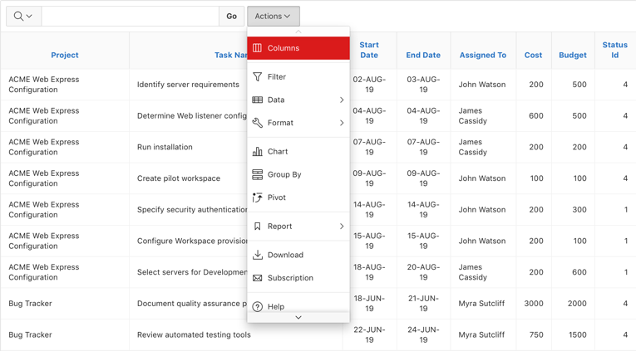
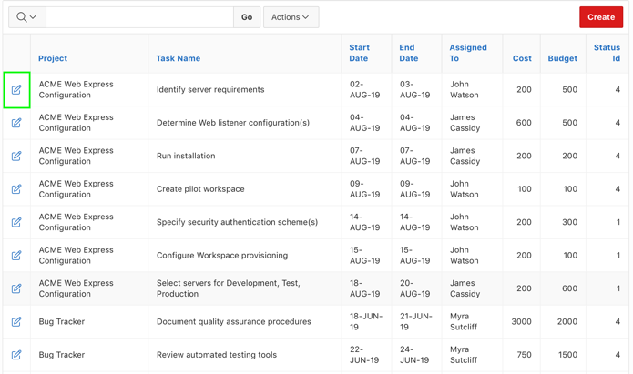
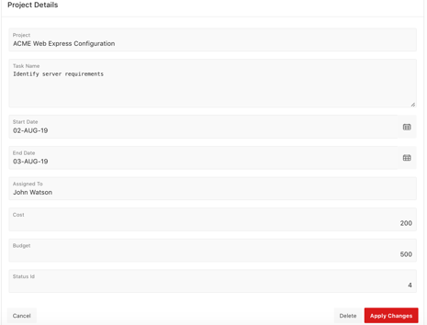
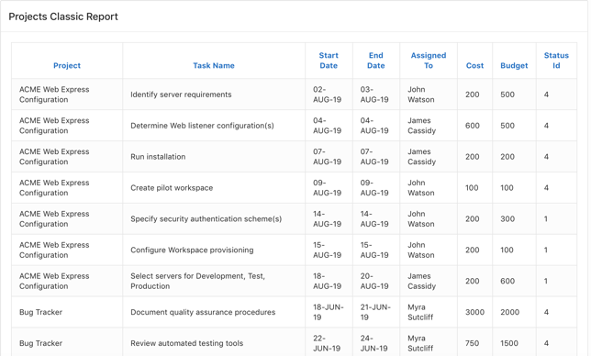
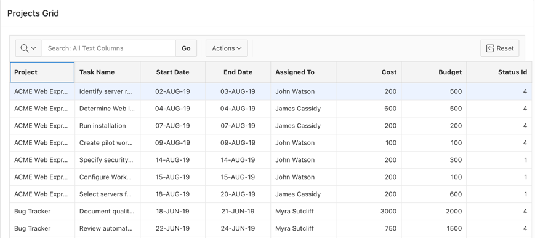
Understanding Different Report Types
A report is the formatted result of a SQL query.
Interactive Report
Report with Form
Classic Report
Interactive Grid
Notes:
In Oracle Application Express, a report is the formatted result of a SQL query. You can generate the SQL query by selecting a table or view in a wizard, or by defining the SQL query manually.
The slide shows examples four basic report types:
Interactive Report
Interactive Grid
Report with Form
Classic Report
The main difference between these different report types is the extent and way in which end users can customize the appearance of the data through searching, filtering, sorting, column selection, highlighting, and other data manipulations. You learn more about each of these report types in this lesson.

Slide 5
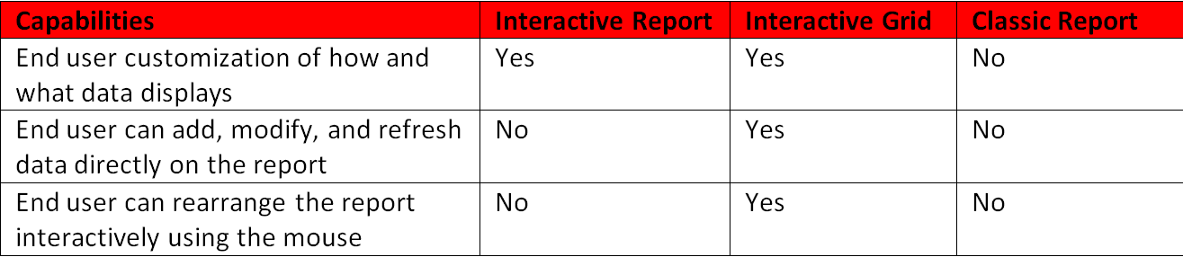
Selecting an Appropriate Report Type
Notes:
The slide shows three different report types: Interactive Report, Interactive Grid, and Classic Report.
Interactive Report: When viewing an interactive report, end users can customize how and what data displays. By default, interactive reports include a search bar, an Actions menu, column heading menus, and Edit icons in the first column of each row. Using options on the Actions menu, users can alter the report layout by hiding or exposing specific columns and applying filters, highlighting, and sorting. You choose an interactive report if your requirement is end user customization.
Interactive Grid: An interactive grid presents users a set of data in a searchable, customizable report. In an editable interactive grid, users can also add to, modify, and refresh the data set directly on the page. Functionally, an interactive grid includes most customization capabilities available in interactive reports plus the ability to rearrange the report interactively using the mouse. You choose an interactive grid if your requirement is to allow end user editing and refreshing directly on the report page along with end user customization of the report.
Classic Report: If you do not need any of the customization, or built-in search bar and drill-down capabilities, then you choose a Classic Report.

Slide 6
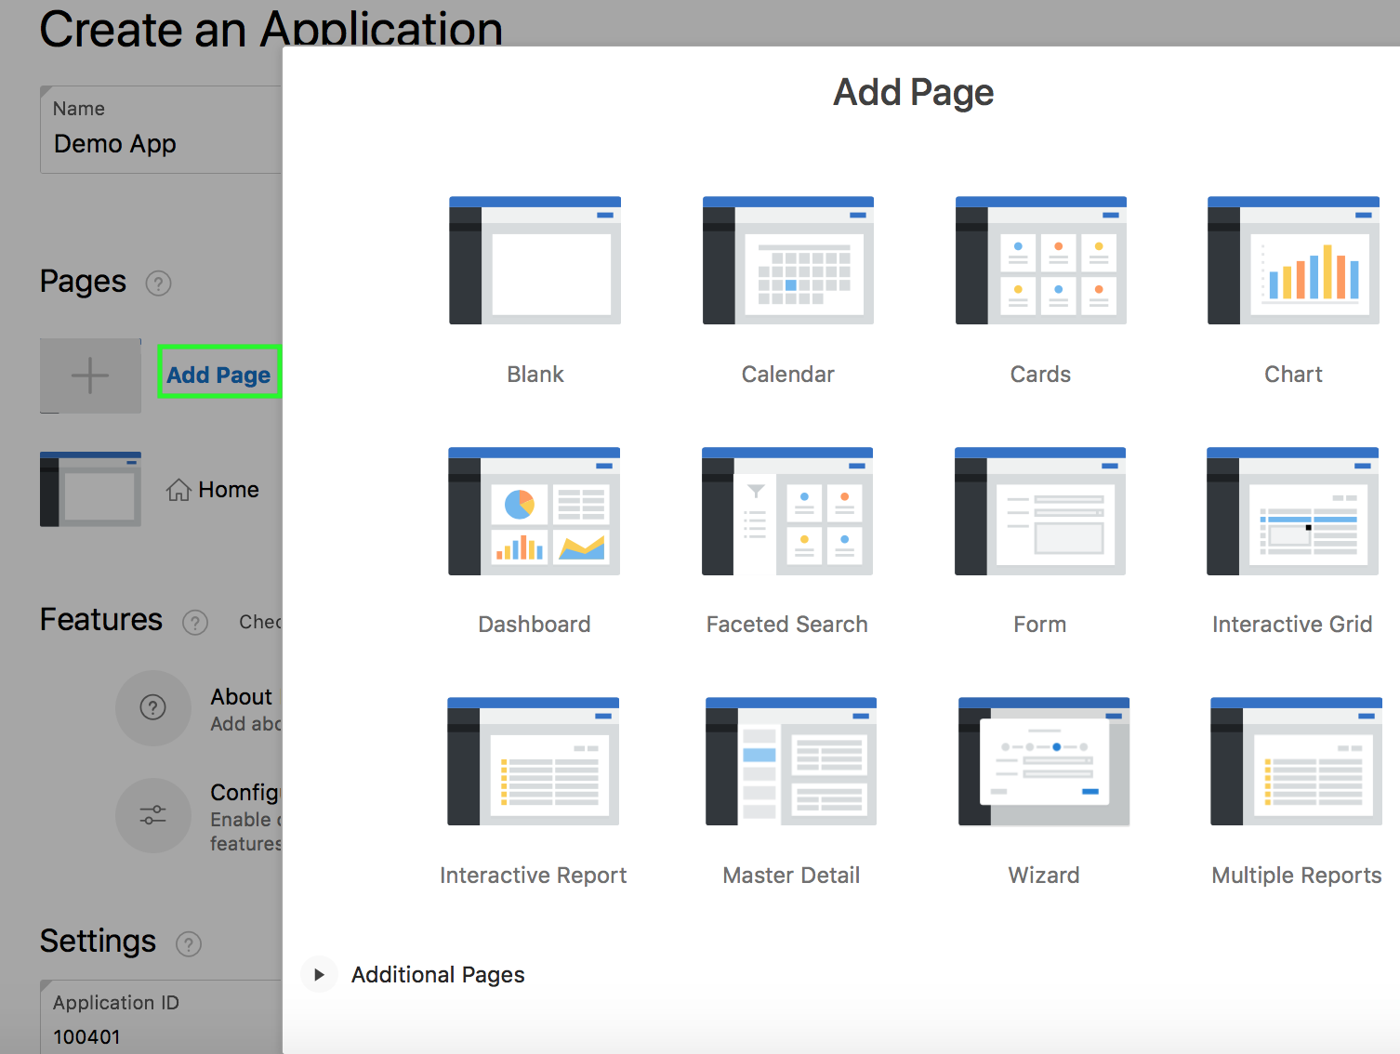
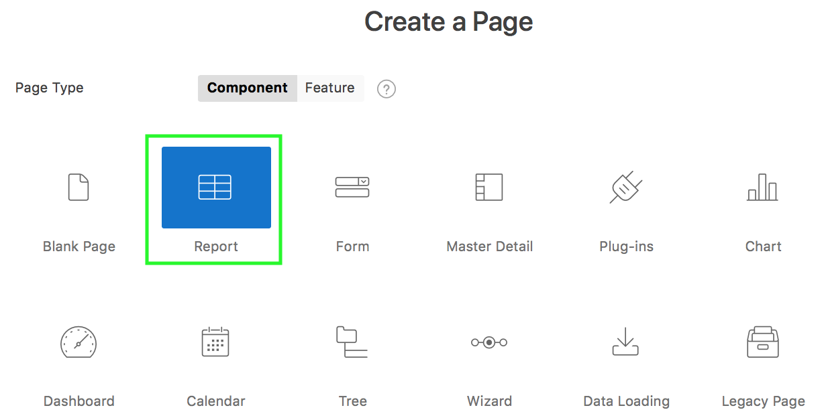
Understanding Different Ways of Creating Reports
Creating a report when you create a new app
Create a report when you create a new database application
Create a report as a new page in an application
Create a report region on a page in an application
Creating a report as a new page in an app
Notes:
Application Express allows you to create reports by running a wizard, or by dragging and dropping the region type in Page Designer. App Builder includes built-in wizards that enable you to generate reports. Using these wizards, you can create a report when you create the following:
A database application
A new page in a database application
When you use the Create Application Wizard and add a report page, supported reports include cards, faceted search, interactive report, classic report, multiple reports, and interactive grid.
Use the Create Page Wizard to create a wide variety of reports on a local database or on an external data source.When you create a page using the Create Page Wizard, supported reports include interactive report, interactive grid, faceted search, classic report, report with form, list view, column toggle report, or reflow report.
The slide shows the Create Application wizard in which you click the Add Page button to add a report page.
The slide also shows the Create Page wizard in which you select the Report component.
See the next slide for more information about how to create a report region on a page.

Slide 7
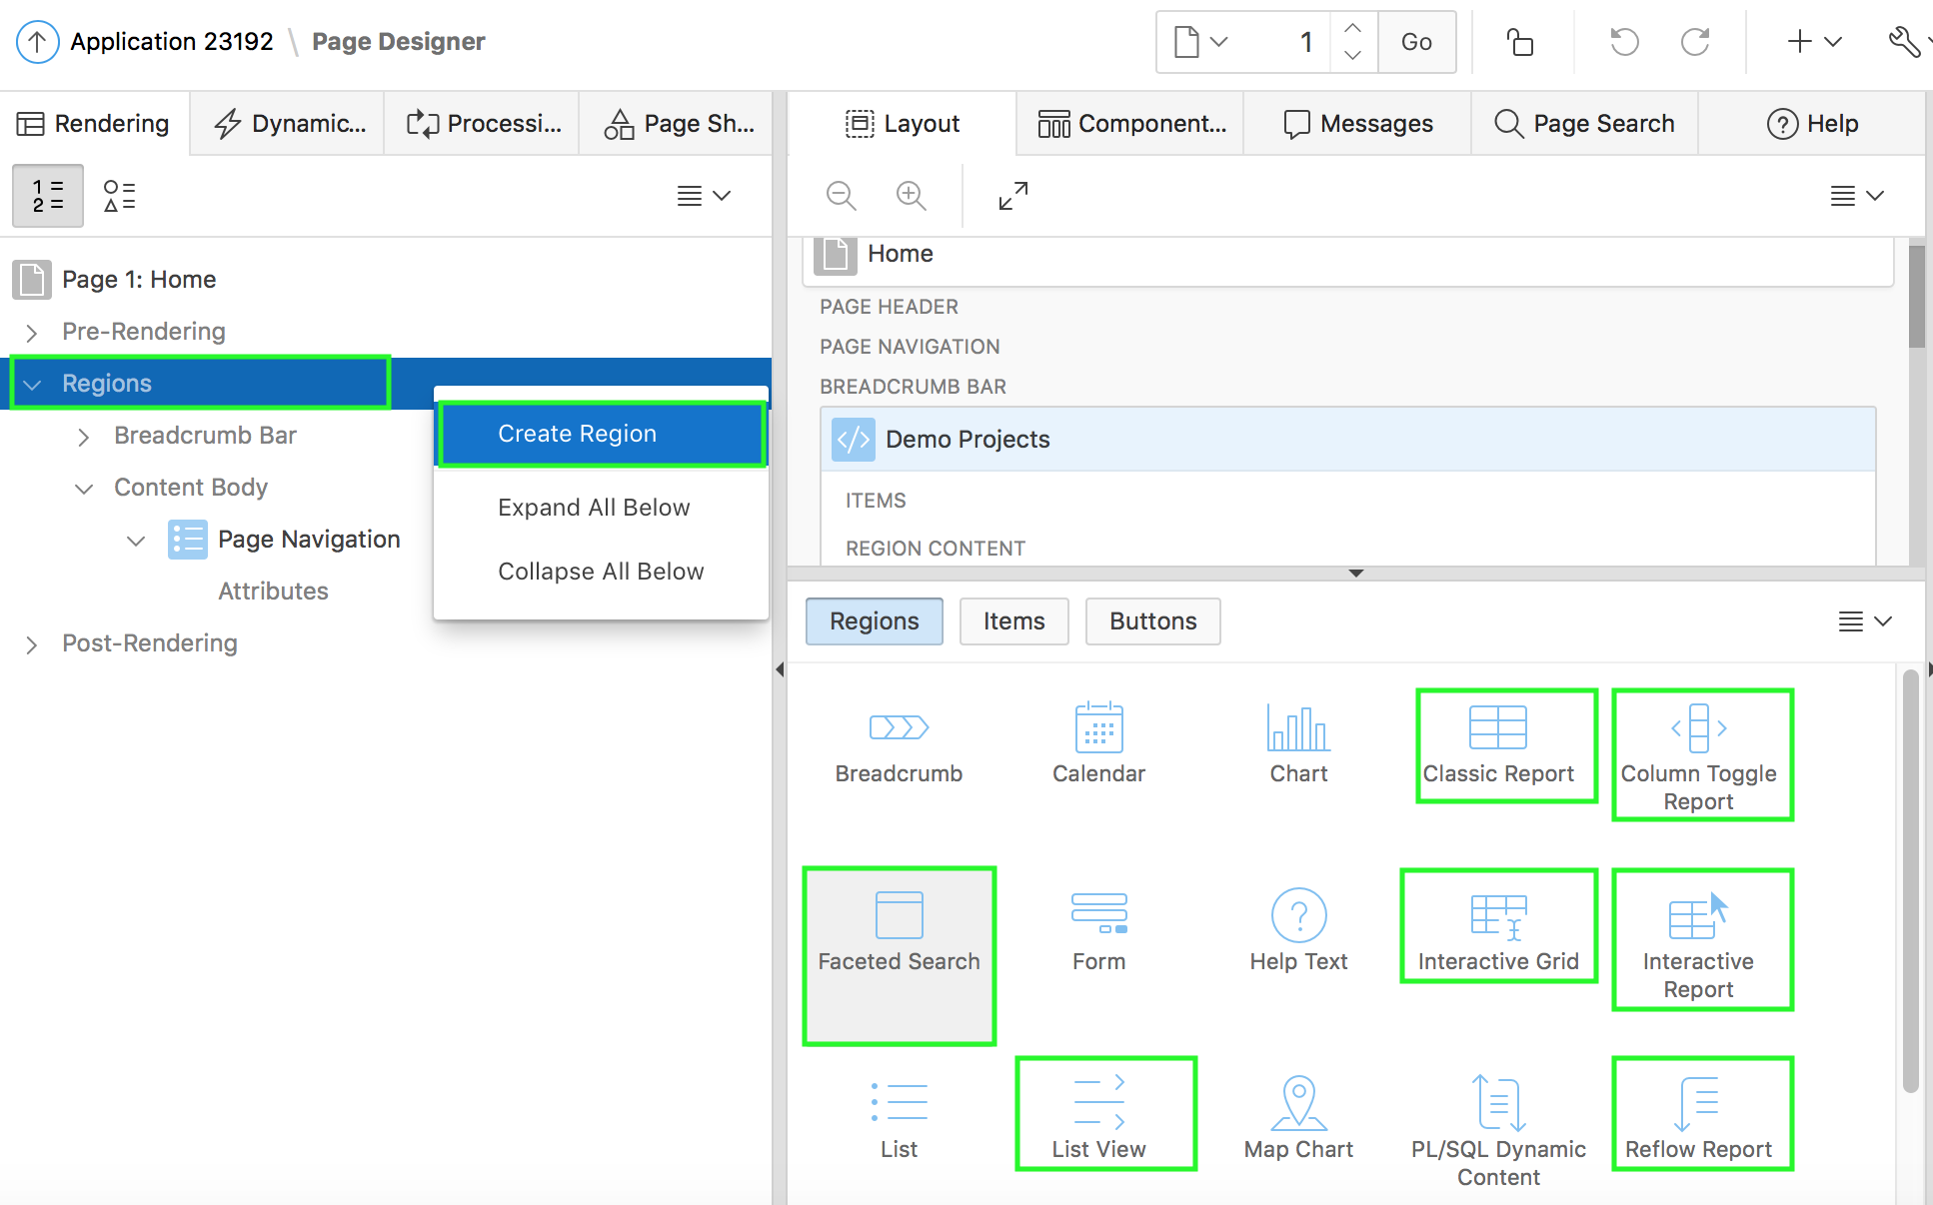
Understanding Different Ways of Creating Reports
Creating a report region on a page in an application
Using the context menu
Drag and drop from the gallery
Notes:
You can also create a report as a region on an existing page in an application. To do this, you view the page definition in page designer. Then, you create a report region by using any of the following options:
Drag and drop a report region from the gallery
Use context menu under the Rendering tab. Click the Rendering tab on the left-pane, and then right-click Regions to view the context menu. Select Create Region
Use gallery context menu. Right-click a report region in the gallery to view a context menu. From the Add To option, select the location where you want to add the report region on the page.

Slide 8
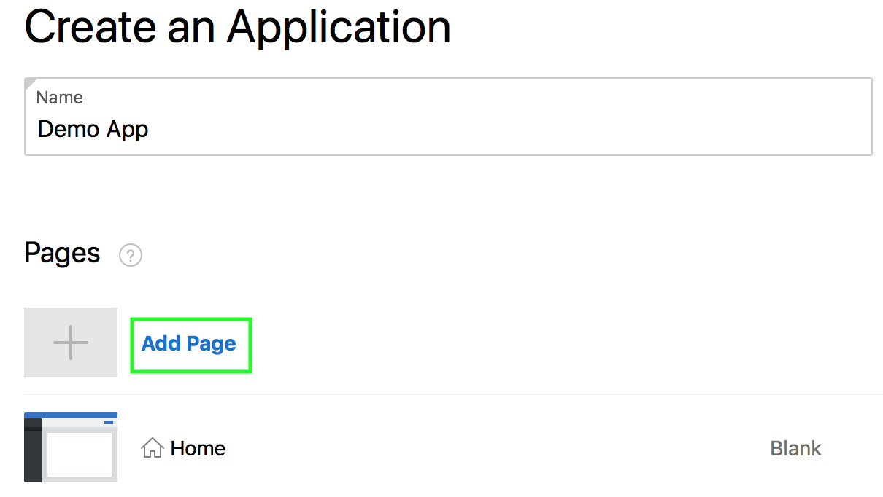
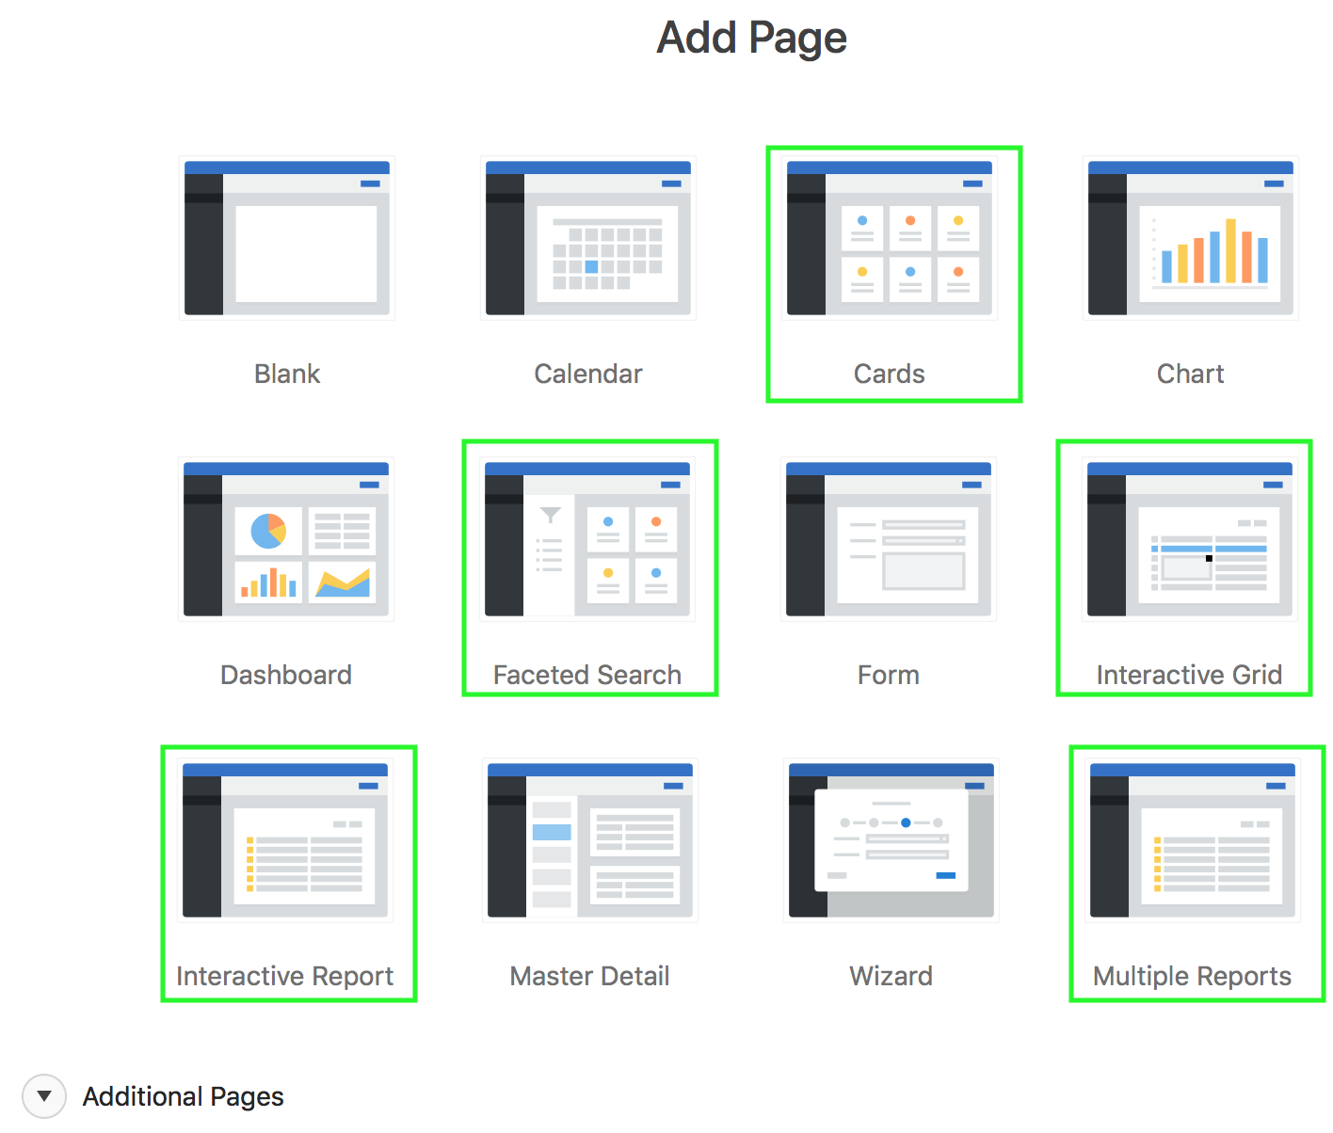
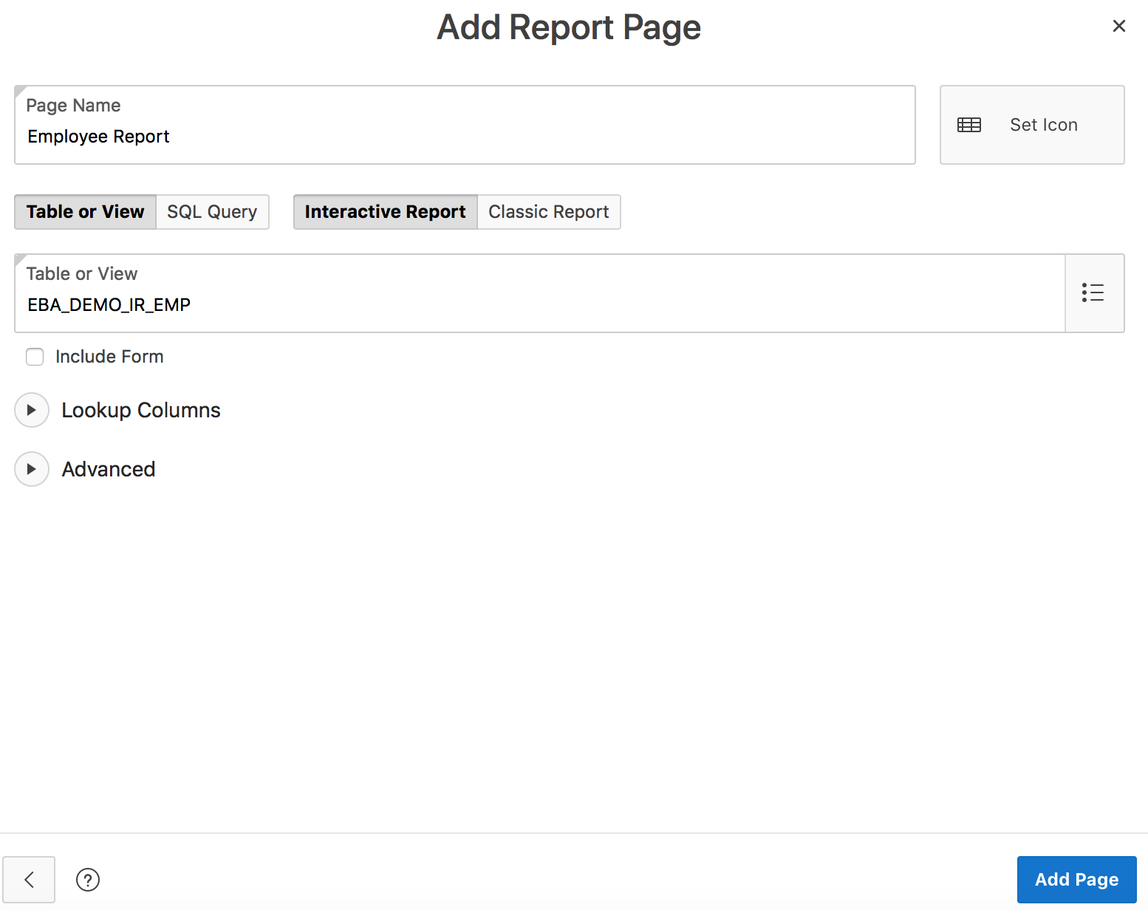
Creating a Report Using the Create Application Wizard
3
1
2
Notes:
By running the Create Application Wizard, you can create a new application that contains one or multiple report pages. Supported report pages using the Create Application Wizard include cards, faceted search, interactive grid, interactive report, and classic report The create application wizard has already been covered in detail in the lesson titled Creating a Database Application.
To create an interactive report or a classic report using the create application wizard, perform the following steps:
On your Workspace home page, click App Builder and then click Create. Select New Application and click Next. Enter a name for your application. Accept the remaining defaults and to add a page, click Add Page.
In the Add Page dialog, select a report of your choice and follow the on-screen instructions.
For example, in the slide, select Interactive Report. In the Add Report Page dialog, perform the following steps:
Enter a name for the report
Select an icon to display in the navigation menu for this page.
Select the source for the report: Table or View or SQL Query. What you select determines what displays next. In the slide example, you select Table or View.
Now, select the type of report page you want to add: Interactive Report or Classic Report. In the slide example, you accept the default selection of Interactive Report.
Select the Table or View. In the slide example, you select EBA_DEMO_IR_EMP.
Optionally select the Include Form check box to include a linked form page to enable users to maintain the table values.
Expand Lookup Columns to see attributes for defining a lookup to another table. Use Lookup Columns to replace identifiers with a display column, such as showing the department name instead of the department number. Note: Lookup Columns only appears if the current page is based on a table or view and has foreign key constraints to another table.
Follow the on-screen instructions and then click Add Page.
Accept the defaults and click Create Application.
You learn how to create an interactive grid by using the Create Application Wizard later in this lesson.

Slide 9
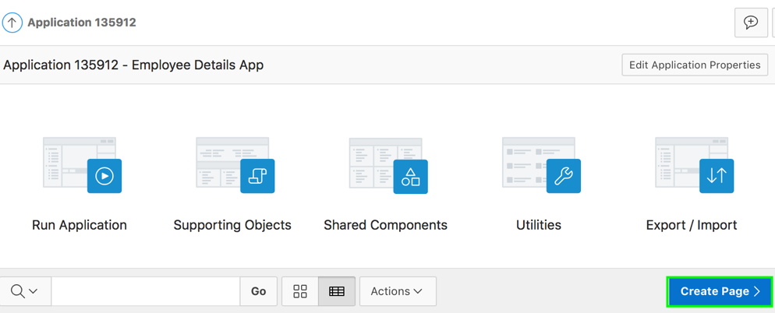
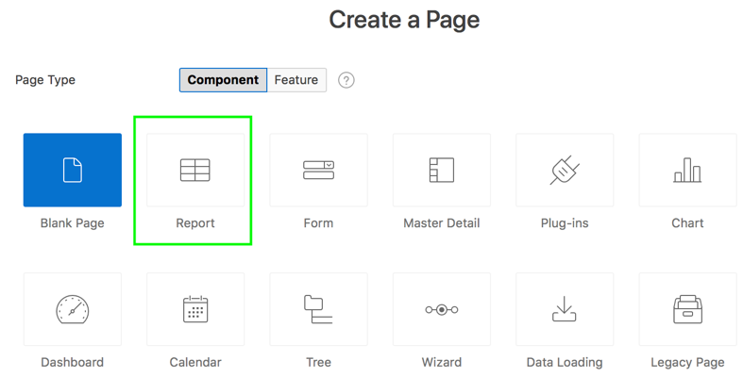
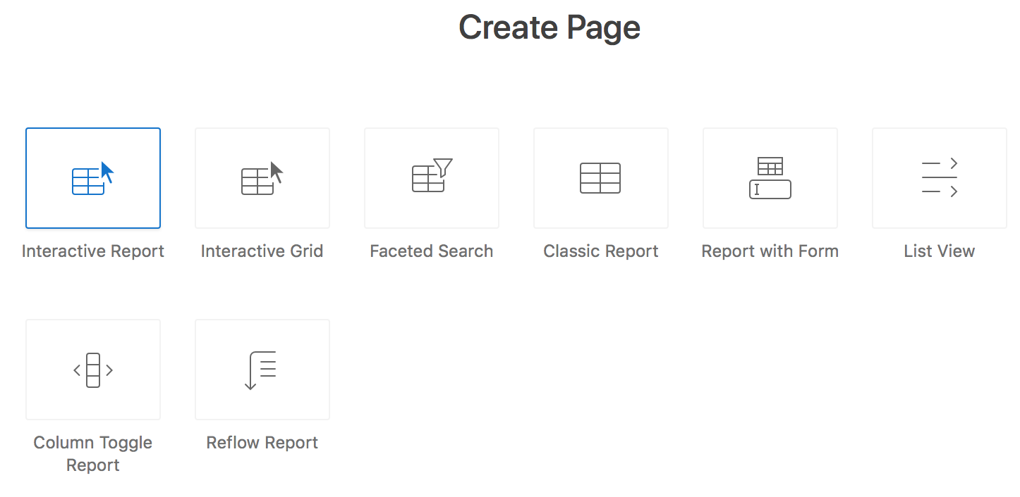
Creating a Report Using the Create Page Wizard
2
1
3
Notes:
In an existing application, you use the Create Page Wizard, to create a wide variety of reports. You can create reports on a local database or on an external data source. The Create Page Wizard supports reports such as interactive report, interactive grid, classic report, faceted search, report with form on table, list view, column toggle report, reflow report, or report on a web service.
To create a report as a new page, perform the following steps:
Navigate to your application home page. Click Create Page
Select Report for page type and click Next
Select a report type from the following options:
Interactive Report
Interactive Grid
Faceted Search
Classic Report
Report with Form
List View (optimized for mobile apps)
Column Toggle Report (optimized for mobile apps)
Reflow Report (optimized for mobile apps)
Click Next. Follow the on-screen instructions.
Note: The slide describes how to create a report by running the Create Page Wizard from the Application home page. You can also run this wizard in Page Designer by clicking the Create menu and selecting Page.

Slide 10
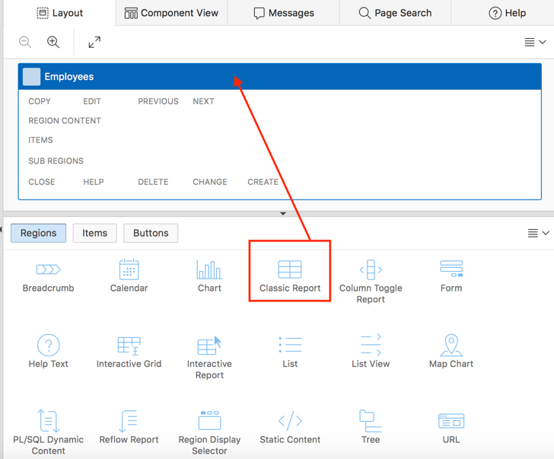
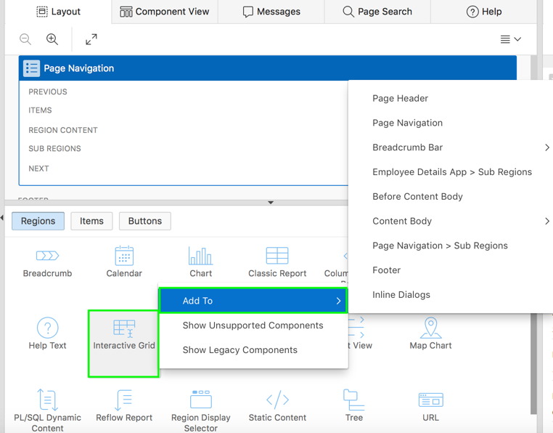
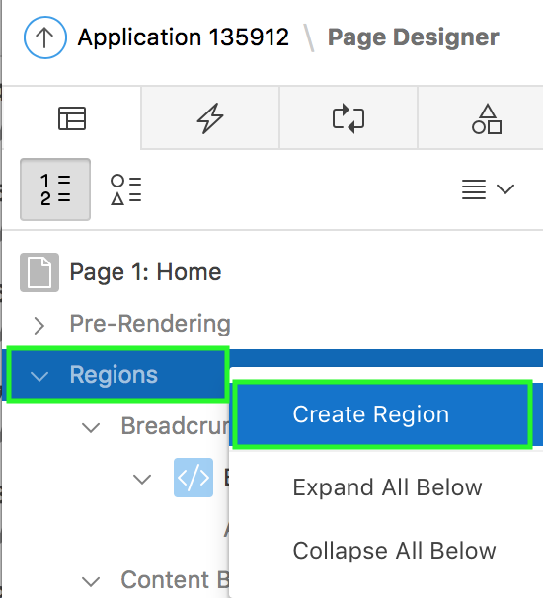
Creating a Report Region in Page Designer
Using context menu
Dragging and dropping from the gallery
Using gallery context menu
Notes:
You can create a new report region on an existing page in an application. When you create a new report region on a page, you have the following two options in page designer:
Drag and drop region from the gallery
Use the context menu
To drag and drop a report region, perform the following steps:
On your application home page, click a page
View the page definition in page designer.
In the gallery at the bottom of the central pane, locate the report region you want to add. The gallery lists all controls or components you can add to a page. Passing the cursor over a control or component displays a tooltip that describes it.
Click and hold the mouse on the region and drag it to the desired location on the Layout tab. When the mouse is over the appropriate location, the Layout tab displays as a darkened yellow tile. Release the mouse to drop the region.
Page Designer indicates what actions are required next. The Messages tab displays a red or yellow badge indicating the number of messages you need to address. Edit the appropriate attributes in Property Editor.
Then, click Save or Save and Run Page
To use the context menu, perform the following steps:
On your application home page, click a page
View the page definition in page designer.
In the left pane, select Rendering tab.
Right-click the Regions node and select Create Region.
Edit the appropriate attributes in the Property Editor.
Then, click Save or Save and Run Page.
Note: Apart from dragging and dropping from the gallery, you can also use the gallery context menus.

Slide 11

What is an Interactive Report?
Notes:
An interactive report is a formatted result of a SQL query. Both the Create Application Wizard and Create Page Wizard support the creation of interactive reports. You choose a table on which to build a report, or provide a custom SQL SELECT statement or a PL/SQL function returning a SQL SELECT statement. Interactive reports are only supported for Desktop applications. End users can customize the report layout and data displayed by selecting options on the Actions menu.
You can restrict the capabilities of interactive reports available to end users (such as disabling download or support for hiding column).
When viewing an interactive report, end users can customize how and what data displays. By default, interactive reports include a search bar, an Actions menu, column heading menus, and Edit icons in the first column of each row. Using options on the Actions menu, users can alter the report layout by hiding or exposing specific columns and applying filters, highlighting, and sorting. They can also define breaks, aggregations, charts, group bys, and add their own computations. Once customized, the report can be saved as either a private or public report.
When defining an interactive report you can:
Include multiple interactive reports per page
Display 100 columns using report columns.
Include 999 rows per column heading filter (if no custom LOV is specified in the column attributes)

Slide 12
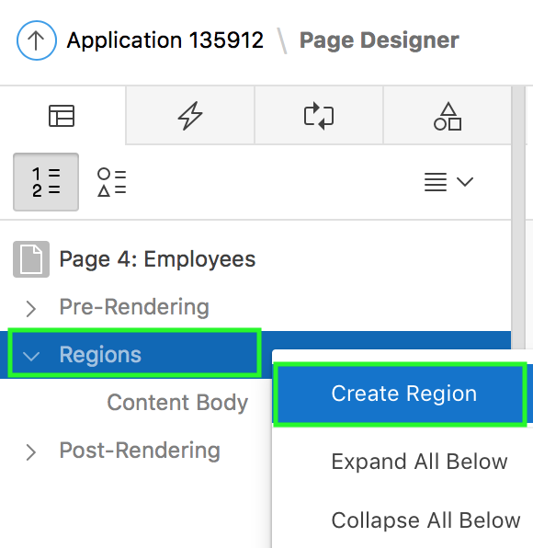
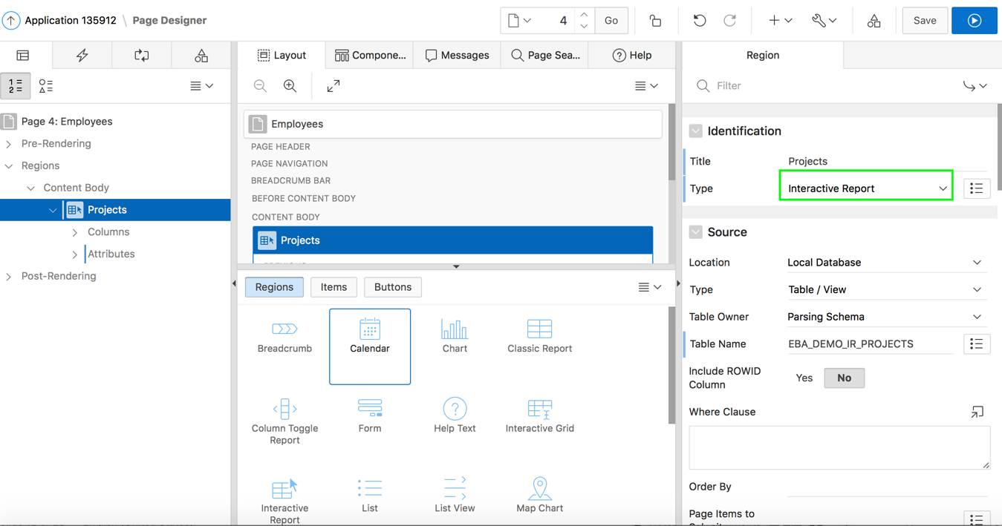
Creating an Interactive Report Region: Example
Using context menu
Notes:
To use the context menu, perform the following steps:
On your application home page, click a page
View the page definition in page designer.
In the left pane, select Rendering tab.
Right-click the Regions node and select Create Region.
Edit the appropriate attributes in the Property Editor.
Under Identification, enter the title of the report and for Type, select Interactive Report
Under Source, for Type, select Table / View and then choose a table name for Table Name. Alternatively, if you select SQL Query for Type, then you click the Code Editor and enter a SELECT statement. In the slide example, you select EBA_DEMO_IR_PROJECTS for Table Name.
Then, click Save or Save and Run Page.

Slide 13
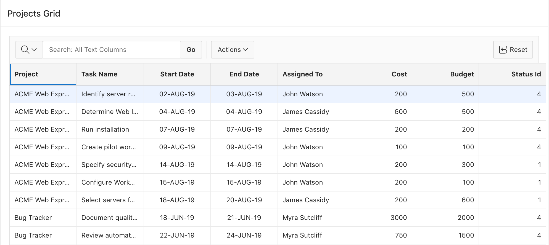
What is an Interactive Grid?
Notes:
An interactive grid presents users a set of data in a searchable, customizable report. In an editable interactive grid, users can also add to, modify, and refresh the data set directly on the page. Functionally, an interactive grid includes most customization capabilities available in interactive reports plus the ability to rearrange the report interactively using the mouse.
Users can lock, hide, filter, freeze, highlight, and sort individual columns with the Actions and Column Heading menus. Advanced users can also define breaks, aggregations, and computations against columns. Users can also directly customize the appearance of an interactive grid. Users can use the mouse to resize the width of a column and drag and drop columns into different places in the grid. Both the Create Application wizard and Create Page wizard support the creation of interactive grids.
Note: Interactive Report generates all the HTML markup on the server as part of the APEX page. The data returned from the SQL query is rendered along with all the other markup that makes up the UI; the toolbar, the dialogs, and everything. The client side behaviors are implemented in a single monolithic JavaScript module. In contrast, Interactive grid does all the HTML rendering on the client. The server provides the data in JSON format. Edits in an interactive grid are saved to the server in JSON format as well.

Slide 14
Understanding Interactive Grid: Key Features
Modern, rich, and interactive multi-row editing component
JSON-based, lightweight AJAX communications
Extensible and customizable
Accessible, key board support, right-to-left support
Upgrade utility for tabular forms
Master Detail / Detail
Master Detail Layout – Any Combination
Notes:
Interactive grid is a rich, client-side region type that allows rapid editing of multiple rows of data in a dynamic, JSON-enabled grid. You can use multiple interactive grids on a single page. Interactive grid includes all the features you expect for powerful reporting, including fixed headers, frozen columns, scroll pagination, multiple filters, sorting, aggregates, computations, and more. You can easily edit your text, numerical data, list of values, and much more.
Built using modern guidelines and techniques, this component of Application Express provides outstanding keyboard support and usability.
Interactive grid is designed to support all item types and item type plug-ins. With interactive grids, you can easily create master-detail relationships, and go any number of levels deep and across. You can create all types of master-detail-detail screens with ease. The slide graphic shows Master Detail Layout of any combination

Slide 15
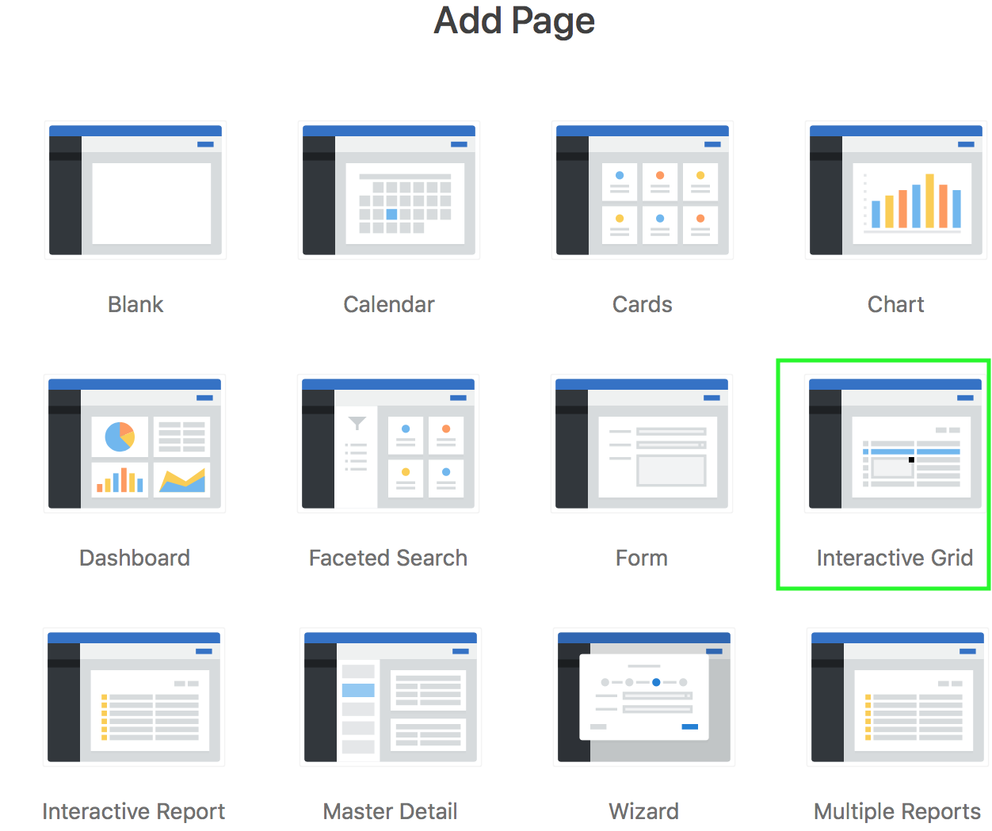
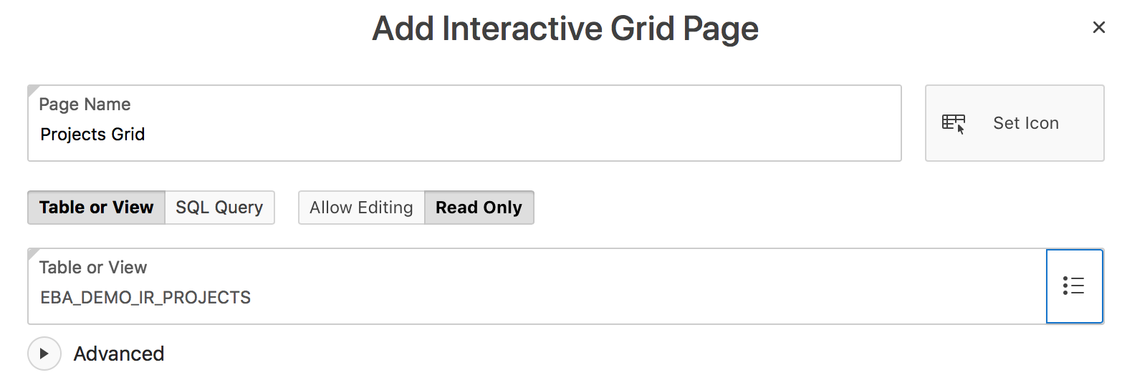
Creating an Interactive Grid: Example 1
Using the Create Application Wizard
Notes:
The slide example shows how to create an interactive grid using the Create Application Wizard. Perform the following steps:
On your Workspace home page, click App Builder and then click Create. Select New Application and click Next. Enter a name for your application. Accept the remaining defaults and to add a page, click Add Page.
In the Add Page dialog, click Interactive Grid.
In the Add Interactive Grid Page dialog:
Enter a name for the page
Select an icon to display in the navigation menu for this page.
Select the source for the report: Table or View or SQL Query. What you select determines what displays next. In the slide example, you select Table or View.
Now, select the grid type you want to add: Allow Editing or Read Only. In the slide example, you select Read Only.
Select the Table or View. In the slide example, you select EBA_DEMO_IG_EMP.
Follow the on-screen instructions and then click Add Page.
Accept the defaults, and click Create Application.
Note: If you select a Query Type of SQL Query plus a Grid Type of Allow Editing and your query joins two or more tables, then the interactive grid generated will fail when users try and update records. Also, if you select Grid Type of Allow Editing and the query (or selected Table or View) uses a view that is not updateable, then the Interactive Grid generated will fail when users try and update records.

Slide 16
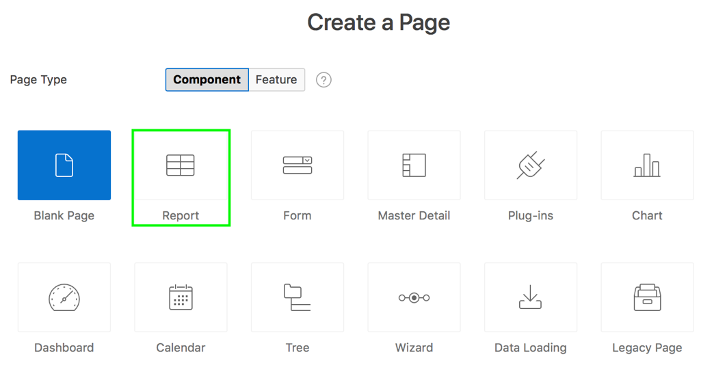
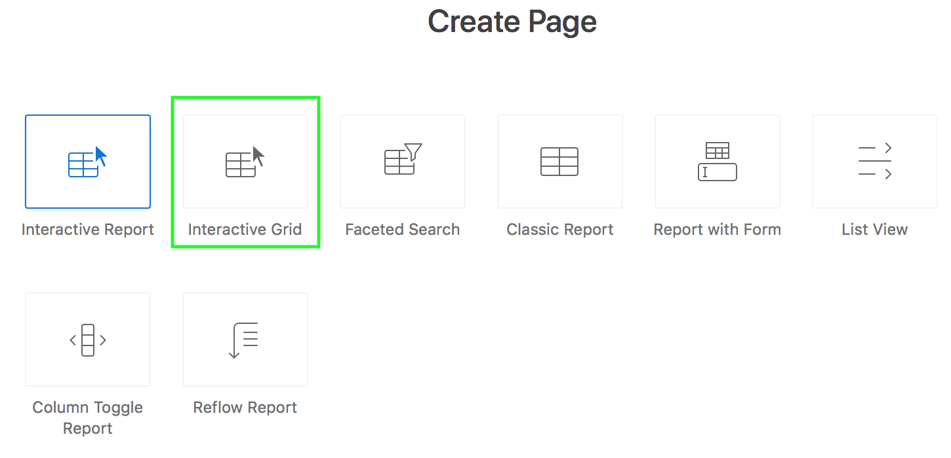
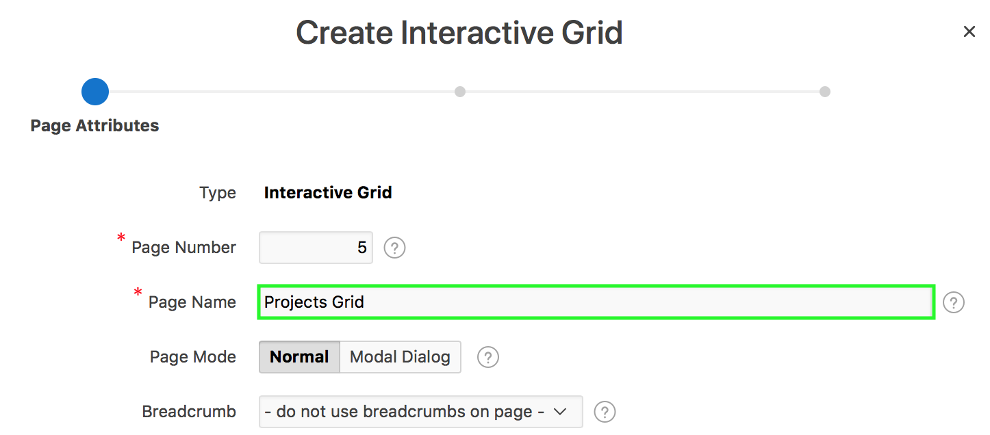
Creating an Interactive Grid: Example 2
1
2
Using the Create Page Wizard
3
Notes:
The slide example shows how to create an interactive grid using the create page wizard. Using the create page wizard, you can create interactive grids on local database on an external data source. To create an interactive grid, perform the following steps:
Navigate to your application home page. Click Create Page. Select Report for page type and click Next.
Select Interactive Grid for report type and click Next.
For Page Attributes, enter a name for Page Name, accept the remaining defaults and click Next. In this step, you can specify if you want to use a breadcrumb navigation control on your page.

Slide 17
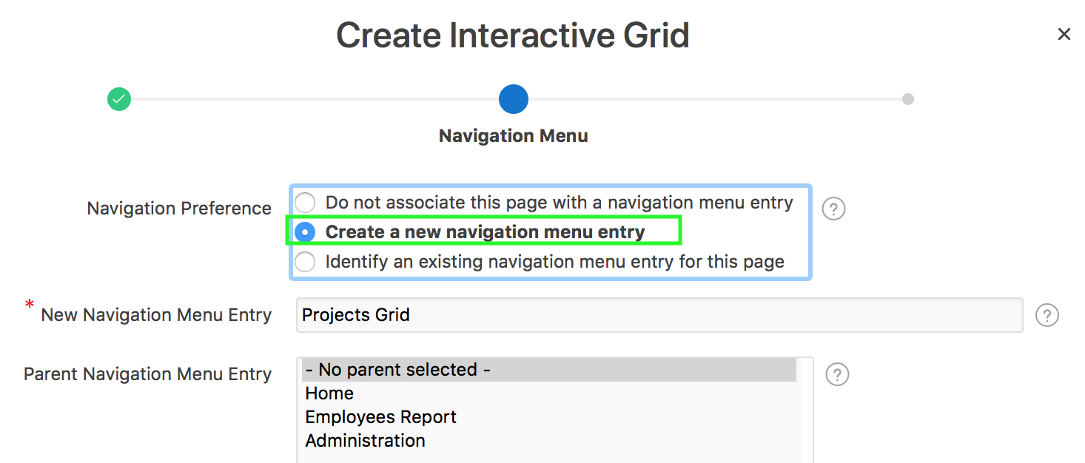
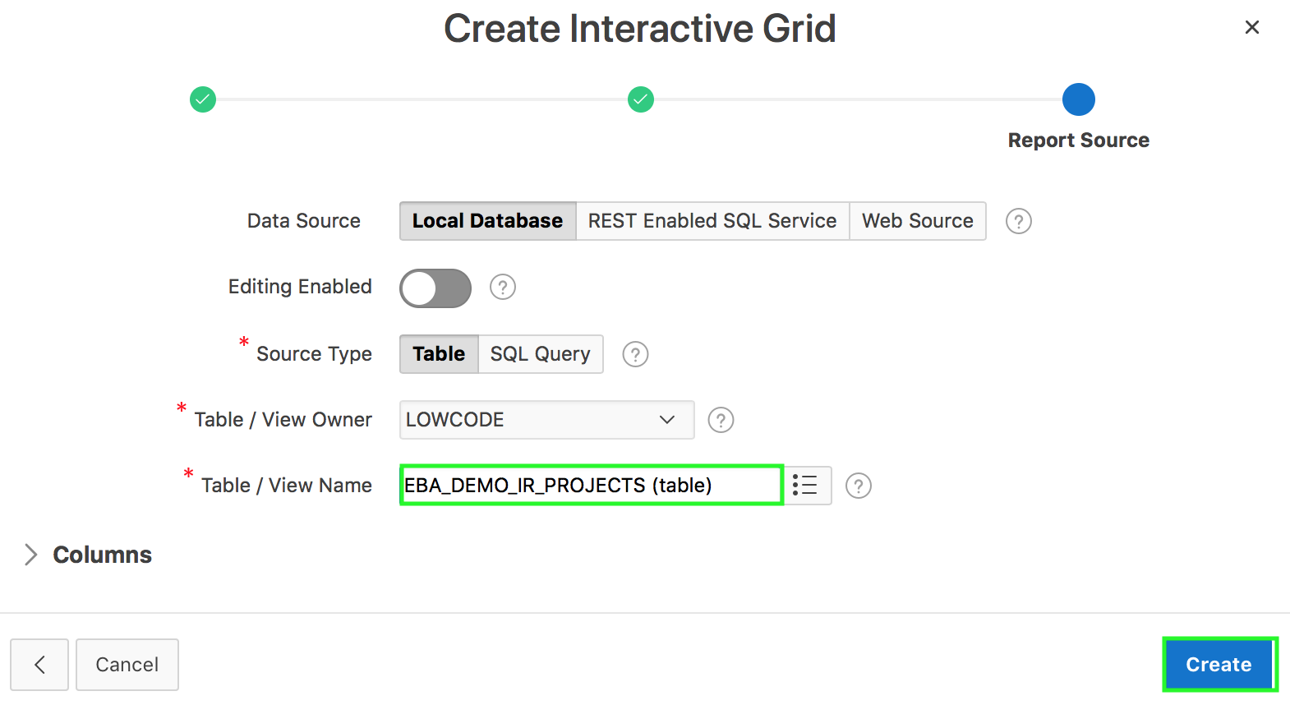
Creating an Interactive Grid: Example 2
4
5
Notes:
Select how you want this page to be integrated into the navigation menu and click Next. In the slide example, you select / enter:
Create new navigation menu entry for Navigation Preference
Projects Grid for New Navigation Menu Entry
For Report Source:
Select if your data source is Local Database, REST Enabled SQL Service or Web Source. In the slide example, the Data Source is Local Database.
Select whether to enable editing for this Interactive Grid. The default selection is No.
Specify the source type to be either a table or a SQL query:
If you select SQL Query source type, enter the SQL and click Create.
If you select Table source type, select the table name, select the columns to be displayed in the report and click Create.
Note:
Data Sources that you can use for APEX components are:
Local Database Data is sourced from the local database.
REST Enabled SQL Service Data is sourced from a remote database, where the connection is defined using REST Enabled SQL. To create or maintain REST Enabled SQL references, navigate to Shared Components > REST Enabled SQL.
Web Source Data is sourced from a RESTful web service defined using Web Source Modules. To create or maintain Web Source Modules, navigate to Shared Components > Web Source Modules.

Slide 18

What is a Classic Report?
Notes:
A classic report is the formatted result of a SQL query. Developers choose a table on which to build a report, or provide a custom SQL SELECT statement or a PL/SQL function returning a SQL SELECT statement. With the exception of sorting and simple filtering, end users cannot customize a classic report.

Slide 19
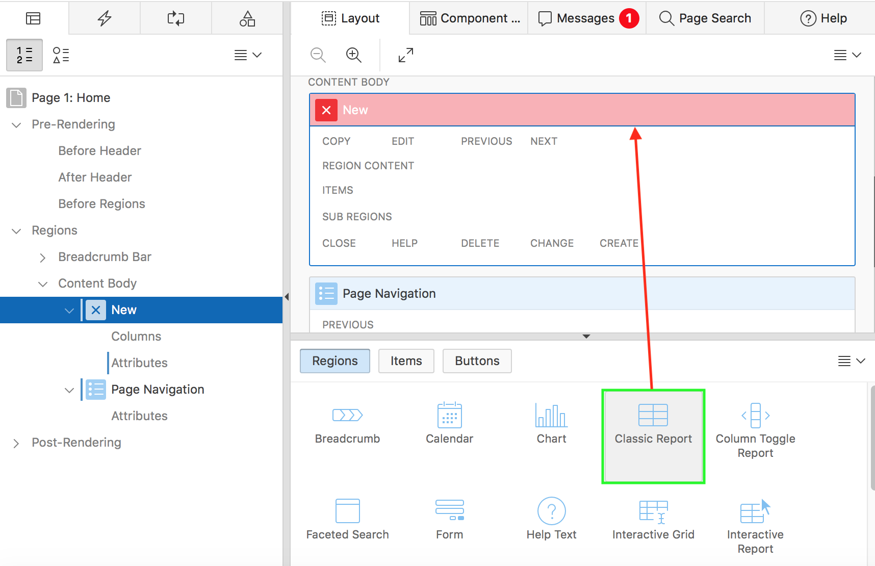
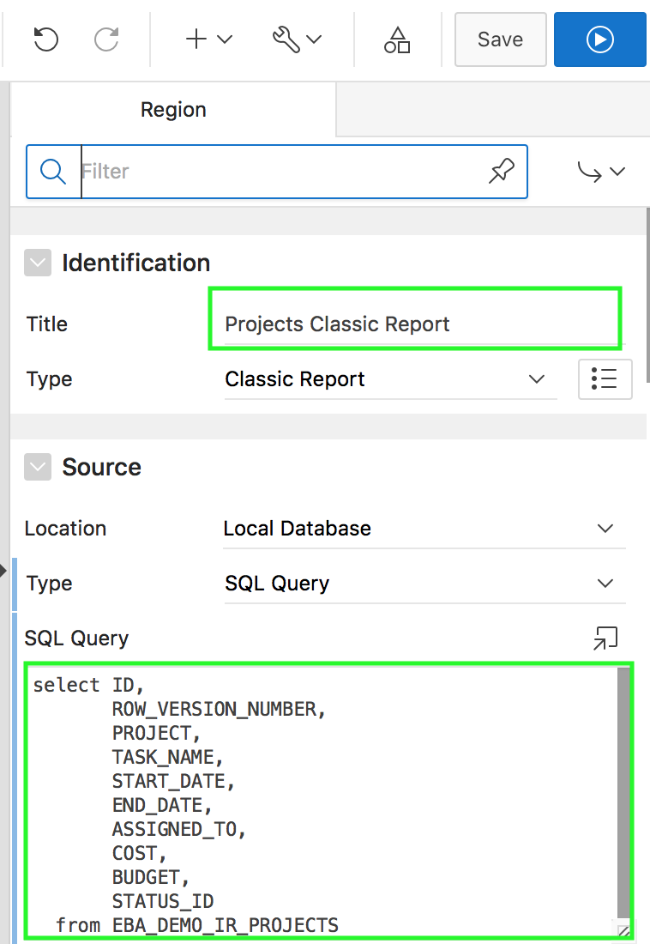
Creating a Classic Report in Page Designer: Example
Dragging and dropping from the gallery
Notes:
The slide example shows creating a Classic Report by dragging the report region from the gallery and dropping it in the CONTENT BODY section of the page.
To drag and drop a classic report region, perform the following steps:
On your application home page, click a page
View the page definition in page designer.
In the gallery at the bottom of the central pane, select Classic Report.
Click and hold the mouse on Classic Report and drag it to the desired location on the Layout tab. When the mouse is over the appropriate location, the Layout tab displays as a darkened yellow tile. Release the mouse to drop the region.
Page Designer indicates what actions are required next. The Messages tab displays a red or yellow badge indicating the number of messages you need to address. Edit the appropriate attributes in Property Editor. In the slide example, under Source, for Type, you select SQL Query. Then, click the Code Editor icon and enter the SQL source for the report
Then, click Save or Save and Run Page

Slide 20

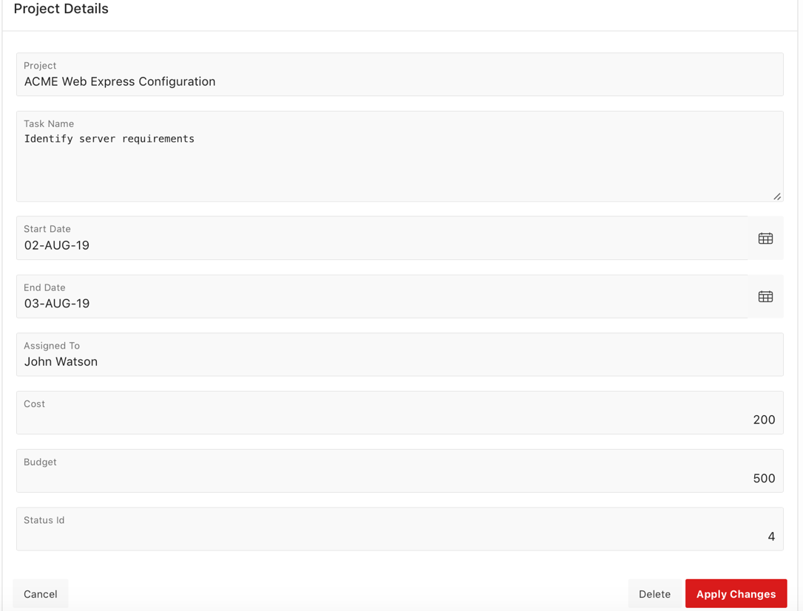
Creating a Report with Form
Notes:
The slide example shows a report and form created on a table. In the report page, each row provides a link (Edit icon) to the second page (form) to enable users to update each record.
Report with Form creates a report (that is, an interactive grid, an interactive report, or a classic report) and form on a table or by providing a SQL query.
Using the Create Application and Create Page wizards you can create a report and form combination. The main difference between these two wizards is that the Create Page Wizard offers more customization and data source options. Using the Create Page Wizard, you select the report type (that is, interactive grid, interactive report, or classic report) and then a data source (that is, Local Database, REST Enabled SQL Service, or Web Source Module). Additionally, you can also specify whether to include and configure breadcrumbs or a navigation menu and select the columns and the order in which they display.

Slide 21
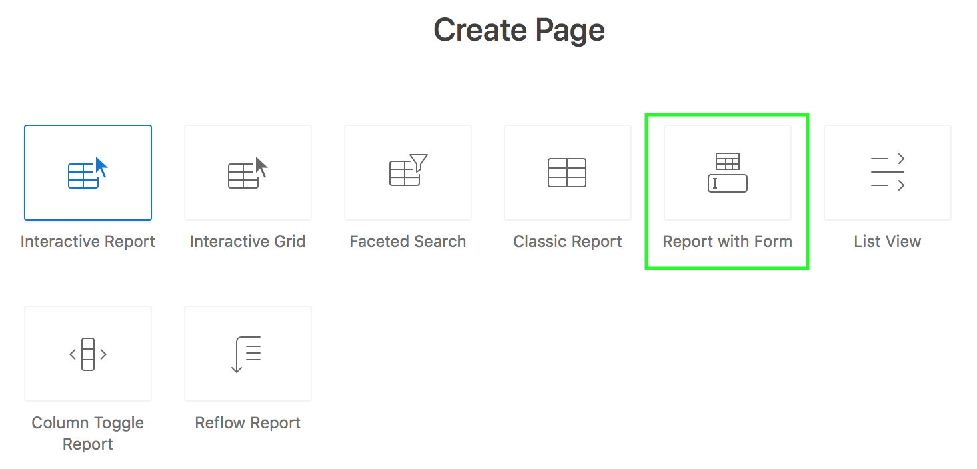
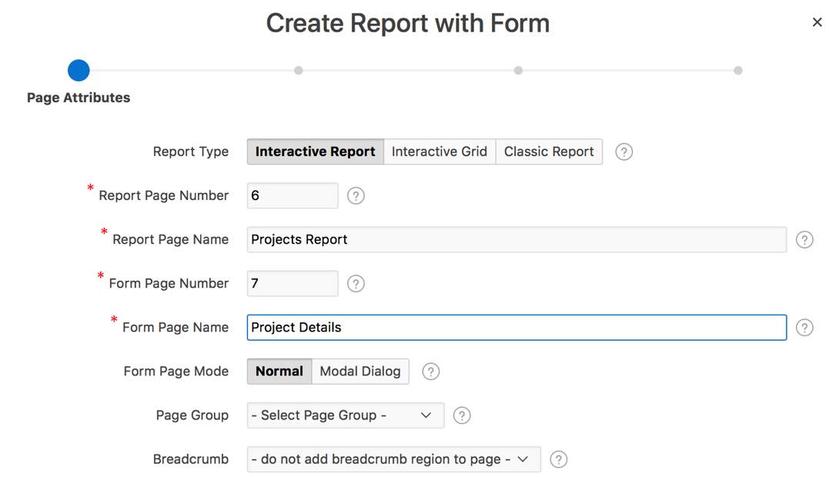
Creating a Report with Form: Example
1
2
Notes:
The slide example shows creating a report with Form by using the Create Page wizard. Perform the following steps:
Navigate to your application home page. Click Create Page. Select Report for page type and click Next. Select Report with Form and click Next.
Specify the page attributes and click Next.
Report Page Name: Enter the title of the page that will contain the report. In the slide example, enter Projects Report
Form Page Name: Enter the title of the page that will contain the form. In the slide example, enter Project Details.
Form Page Mode: Select the page mode to be either Normal or Modal Dialog. You already learned about page modes.
Breadcrumb: Select whether you want to use a breadcrumb navigation control on your page. Select a page for Parent Entry and specify the breadcrumb name for Entry Name

Slide 22
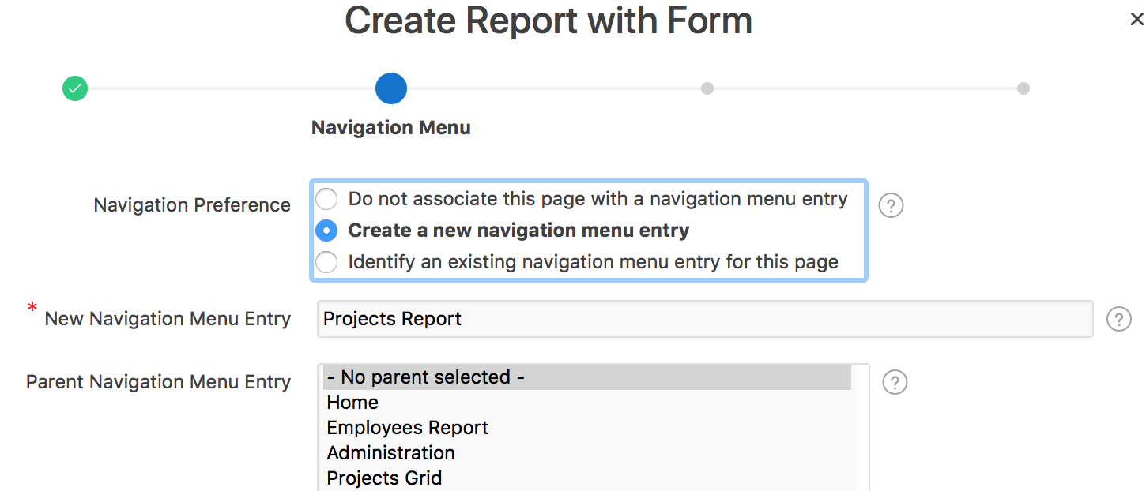
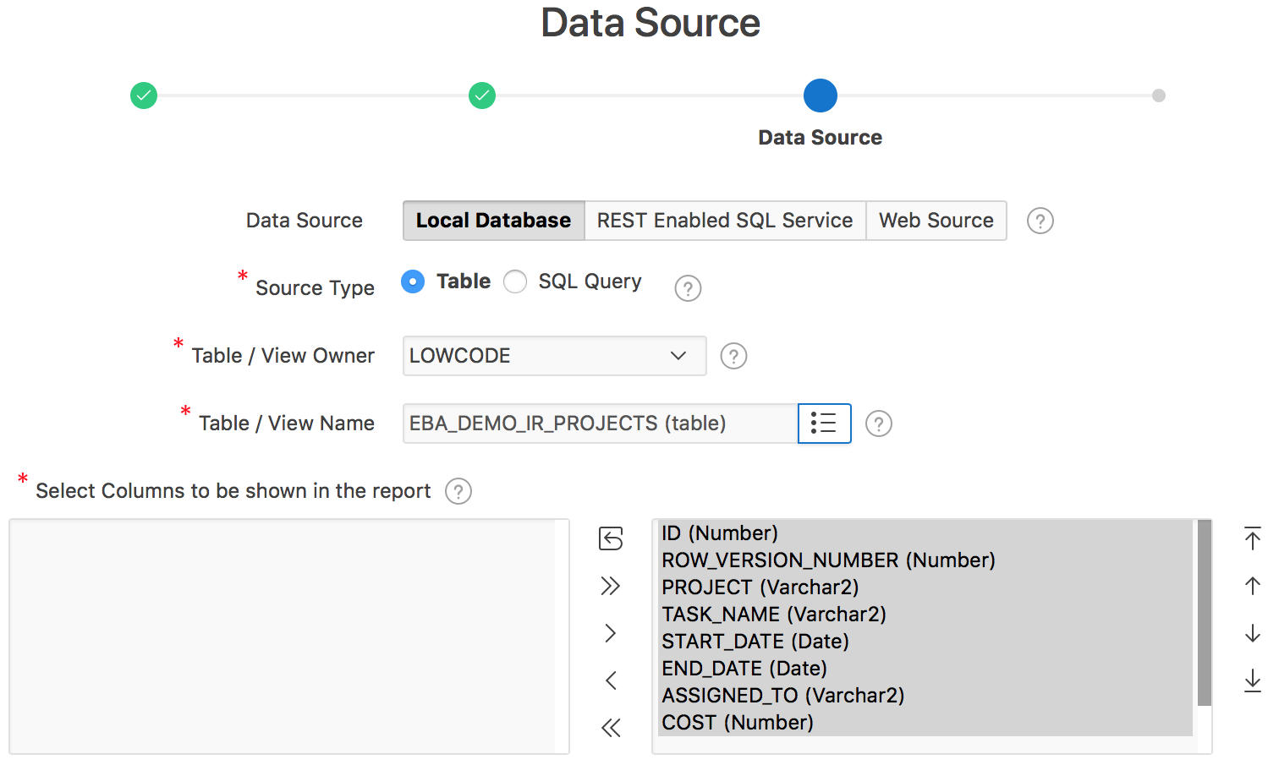
Creating a Report with Form: Example
3
4
Notes:
Specify your preferences for navigation menu and click Next
Select the Data Source type for the Report with Form. Local Database is selected by default. Select the table or view on which the report will be based. In the slide example, you select EBA_DEMO_IR_PROJECTS table. Select column(s) that you want to be shown in the report and click Next

Slide 23
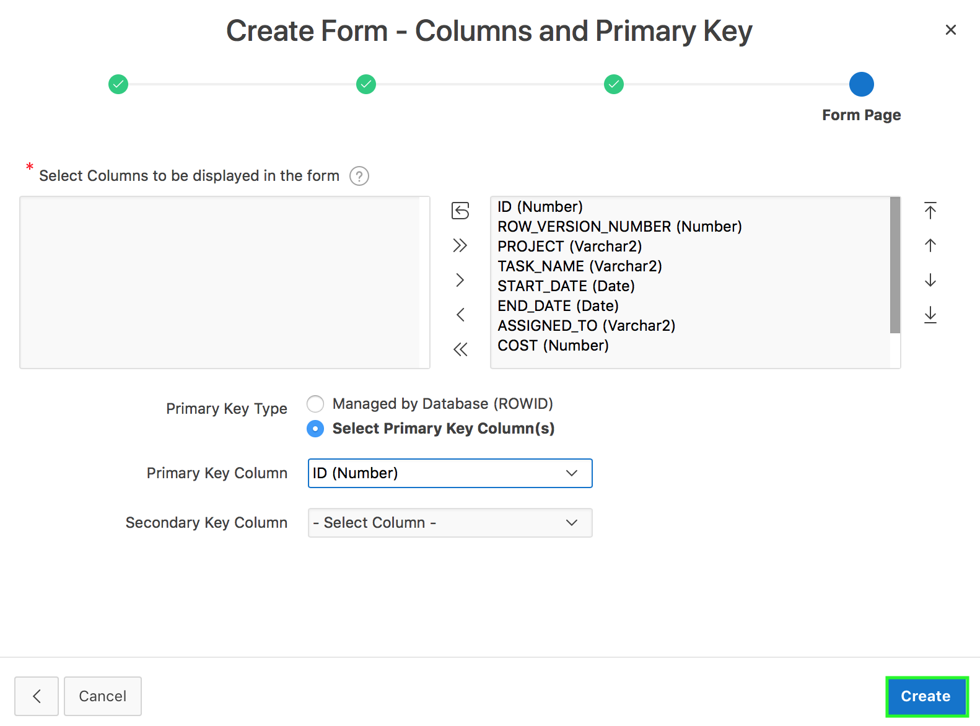
Creating a Report with Form: Example
5
Notes:
Select your choice for Primary Key Type. Choose Managed by Database (ROWID) to have the form use the ROWID pseudo column to identify rows to update and delete. Choose Select Primary Key Column(s) to use the source table's primary key column(s). Select column(s) to be included in the form and click Create. To view the report and form that you just created, click Save and Run Page.

Slide 24
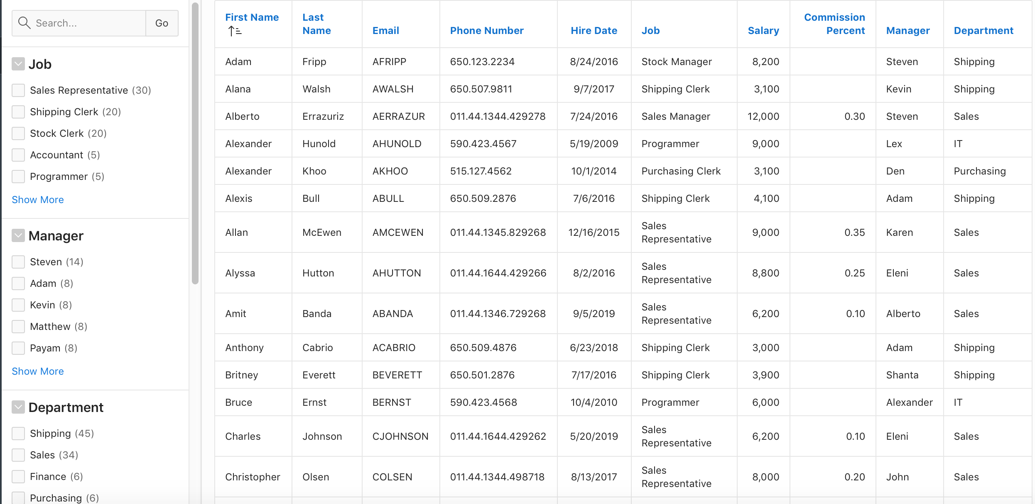
Creating a Faceted Search Page
Notes:
Faceted Search is seen often on the internet typically on shop or sales web sites. The end user can set filters using Facets on the left or upper side of the screen. A facet shows possible values together with the occurrence count within the result set. After the end user changed a facet, results, dependent facets and occurrence counts refresh immediately.
A faceted search page features a faceted search region and report. The faceted search region displays on the left side of the page and enables users to narrow down the search result by selecting facet values. Narrowing the search result, makes it easier for users to find the data they want. The right side of the results region is a classic report which displays in report or card view. Both the Create Application Wizard and Create Page Wizard support the creation of faceted search pages. The slide shows an example of the faceted search page created on the OEHR_EMPLOYEES table.

Slide 25
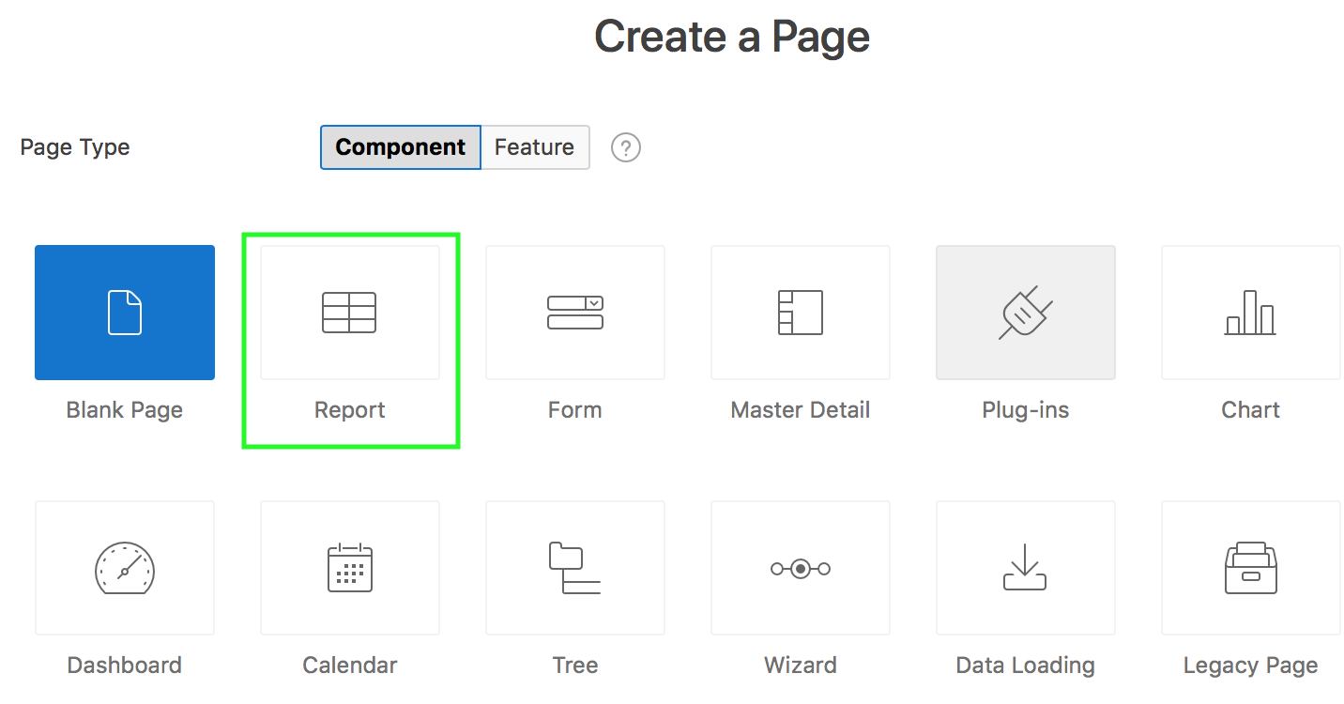
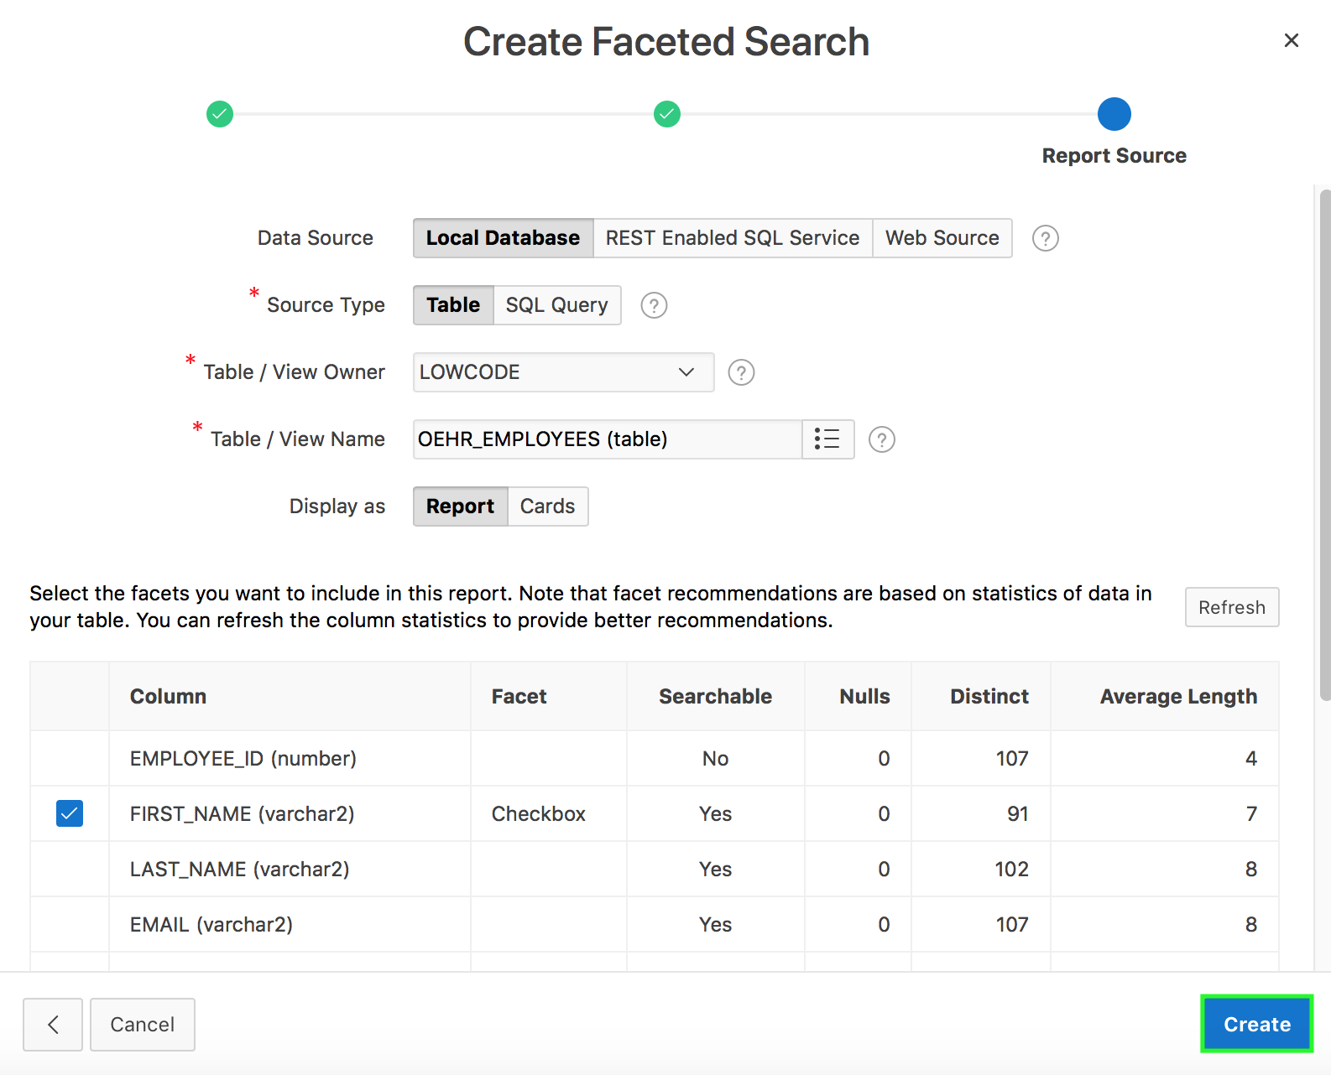
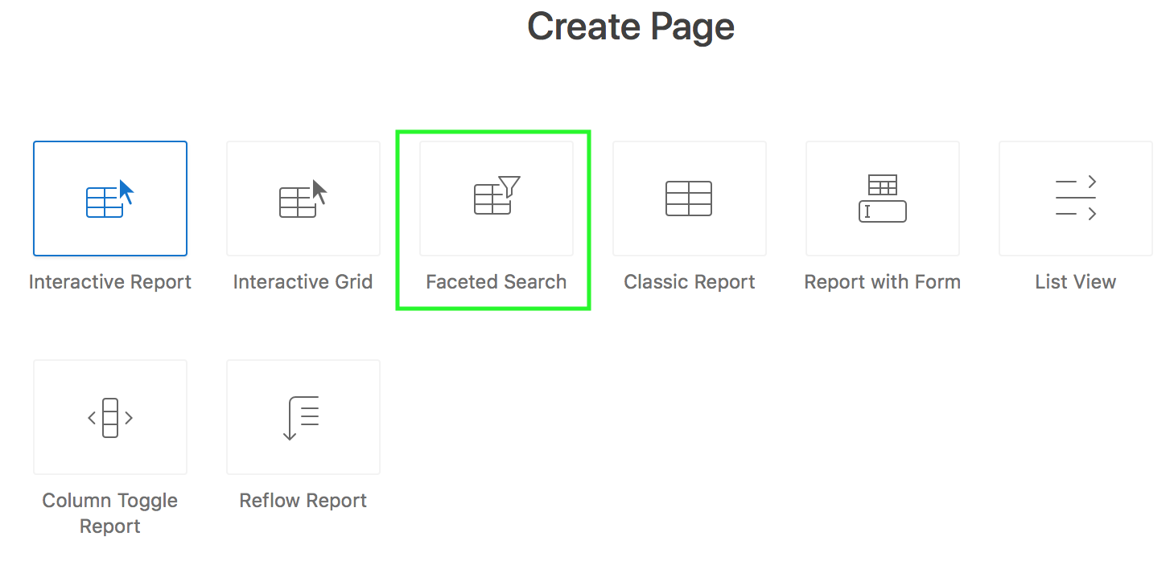
Creating a Faceted Search Page: Example
Notes:
The slide shows an example of creating a faceted search page on the OEHR_EMPLOYEES table. In the example, you use the Create Page Wizard.
To add a new faceted search page to an existing application, perform the following steps:
On your application home page, click Create Page.
Select Report and then select Faceted Search.
Specify the page attributes and click Next.
Select your navigation preference and click Next
Select a data source for the page. You can create a Faceted Search page for tables and SQL queries; for the local database, REST Enabled SQL services and REST services. For local tables, APEX maintains a dictionary cache, containing information about table columns, foreign keys, and actual data,. Based on this cache, APEX can propose appropriate facets and create them automatically.
Click Create.
In the slide example, based on the dictionary cache, APEX is able to follow the foreign key relationship to the OEHR_DEPARTMENTS table, and to create the facet with appropriate display values.

Slide 26
Summary
In this lesson, you learned how to create different types of reports in Oracle Application Express. You learned to create:
Interactive reports
Interactive grids
Classic reports
Report with Form
Faceted Search
Notes:
In this lesson, you learned how to create different types of reports in Oracle Application Express.

Slide 27


Slide 28
Hands-on Lab

